Slide 1

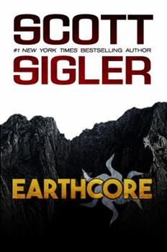
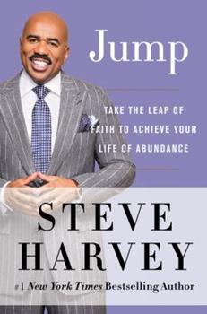

Your Book Is Your Greatest Marketing and PR Asset: Use It!
With
Ivy Slater

Slide 2

Strategies You Need to Ensure Your Book Is an Asset to Build Your Network
*Strategies you need to ensure your book is an asset to build your network.
* Creating a speaking platform with your book
* Your book is your greatest marketing and PR tool. From podcasts, TV, print, etc., exposure has a ripple effect.
* The people you interviewed for your book are a key asset. How do you engage them for mutual success.
* The key differences between just selling a book and acquiring customers for life.

Slide 3
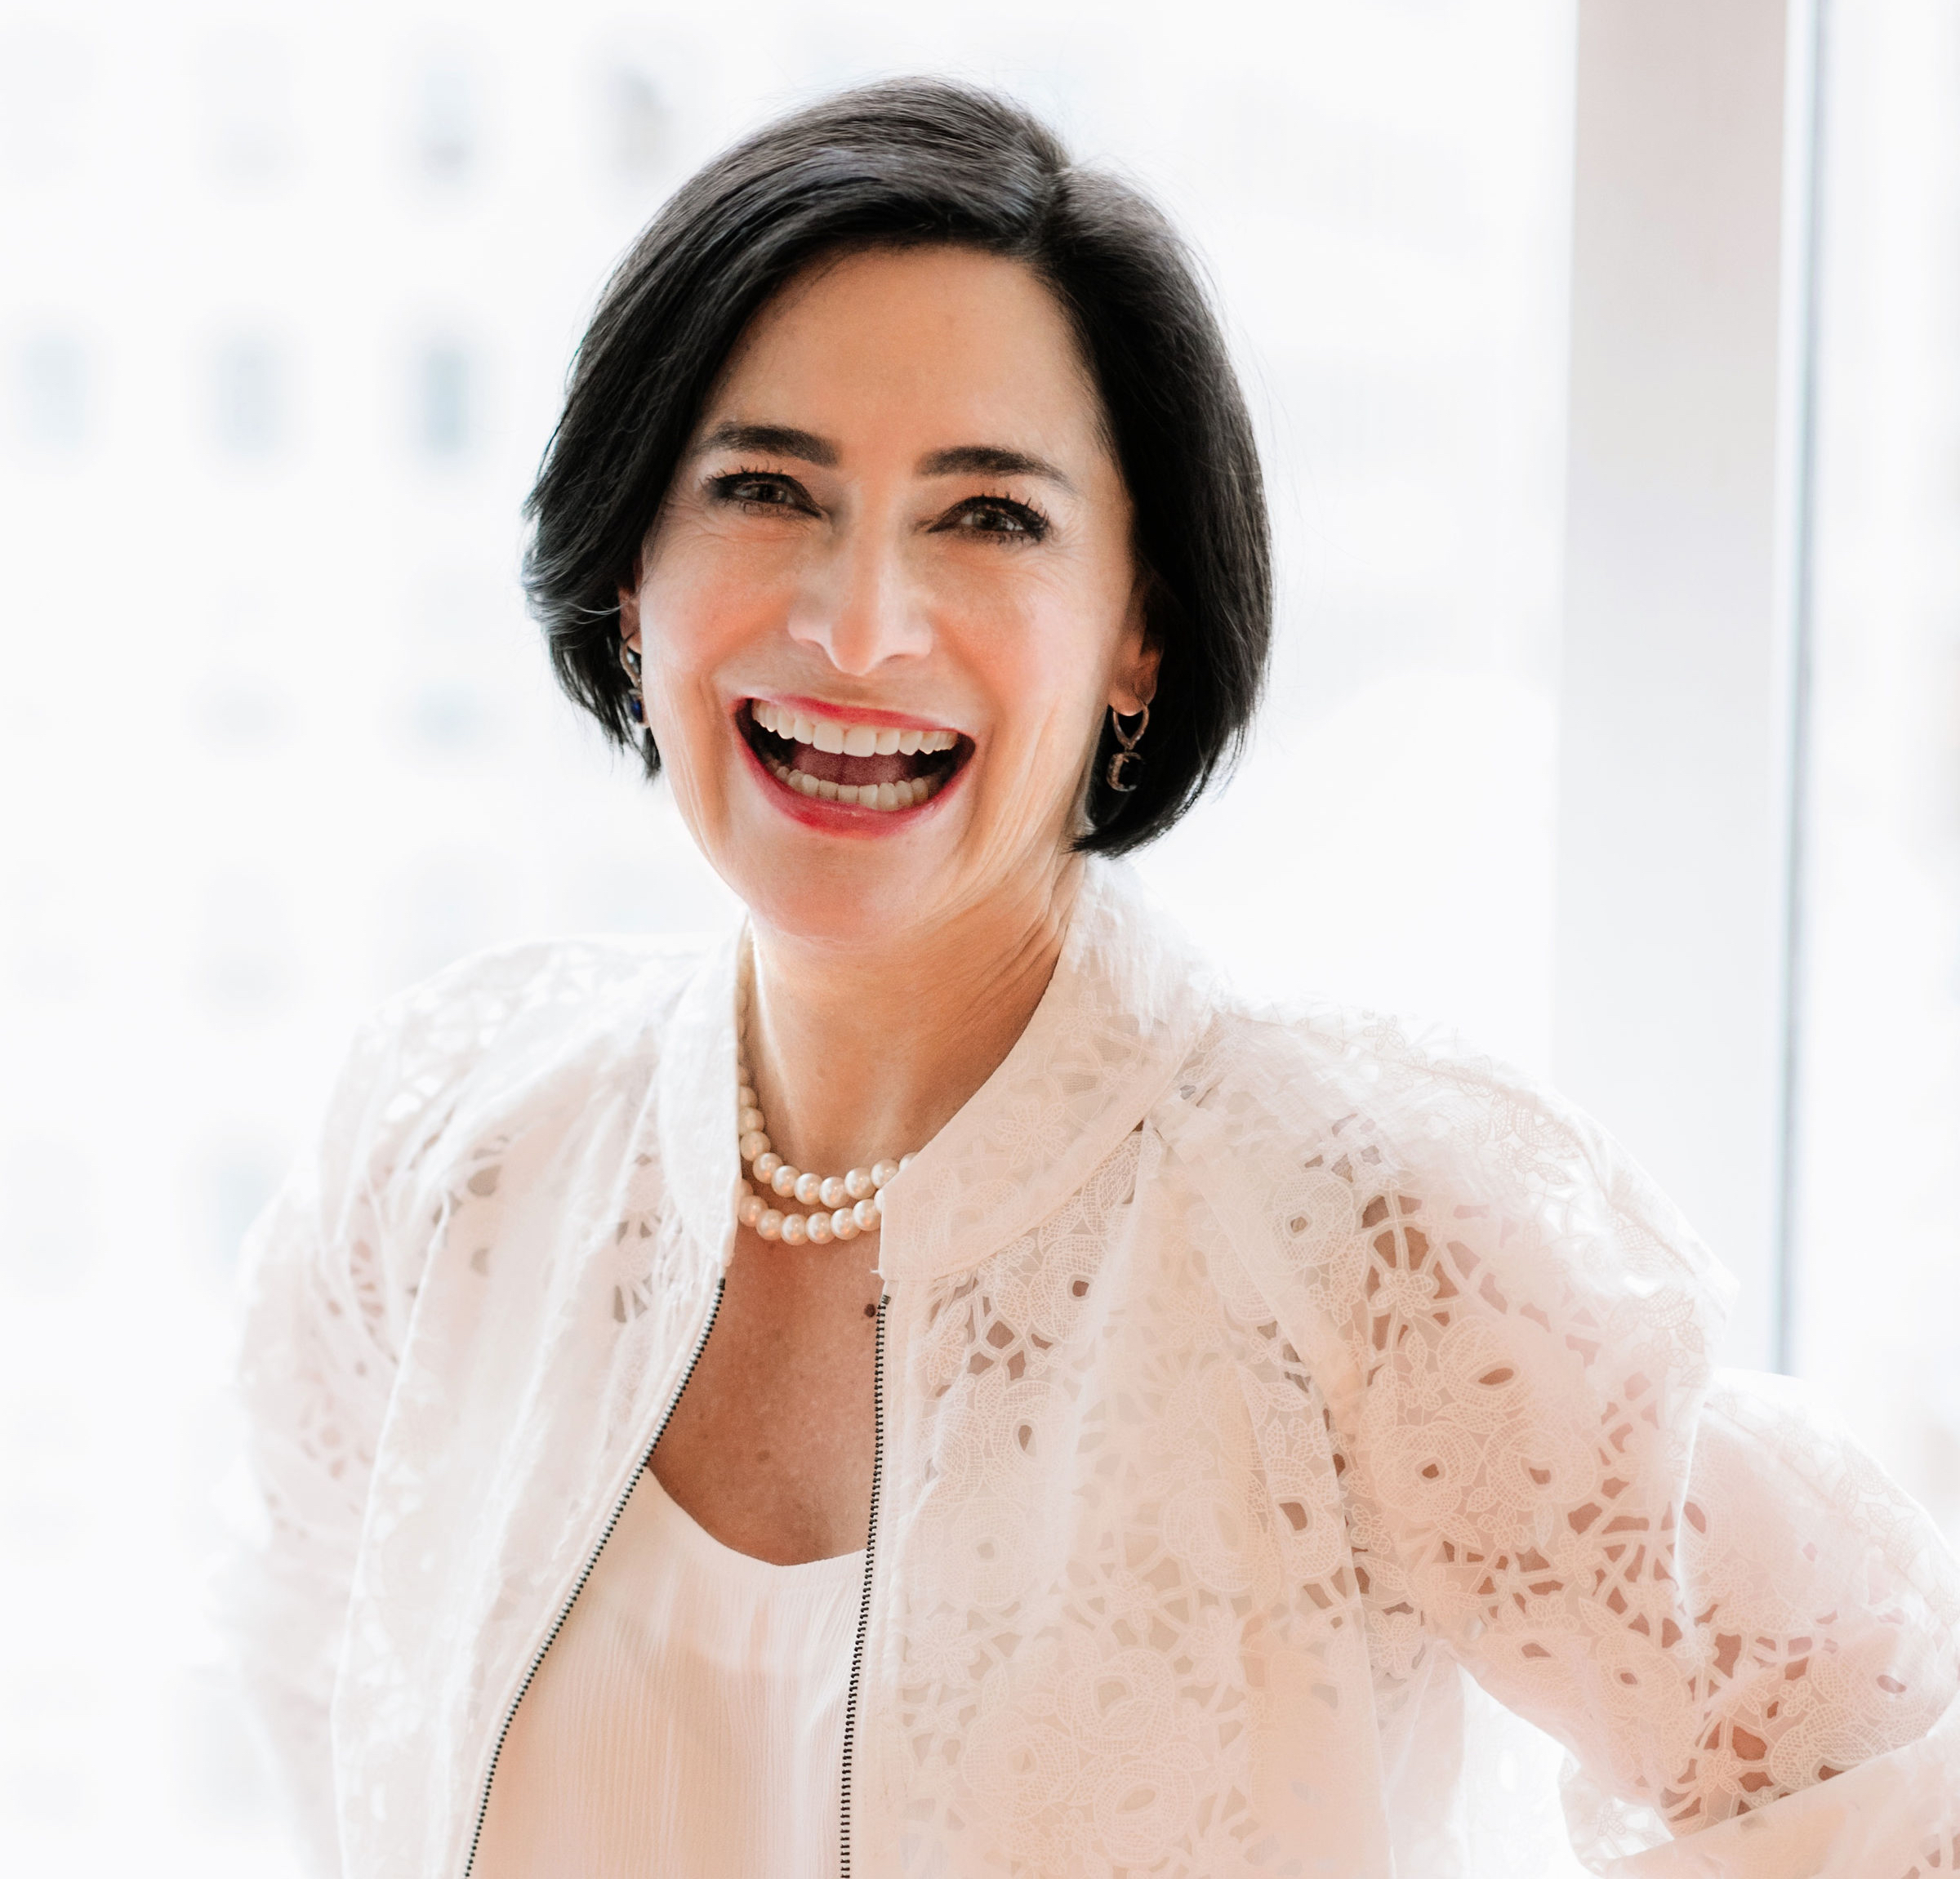

IVY SLATER
SPEAKER – Aon, Athena International, Key Bank, Van Cleef & Arpel, Dress for Success
AUTHOR – From the Barre to the Boardroom & Conquering Your Fear of Money
PODCAST – Her Success Story
COACH & CONSULTANT – Helping companies grow and scale, reaching their short- and long-term success goals
SLATER SUCCESS LIVE – On LinkedIn

Slide 4
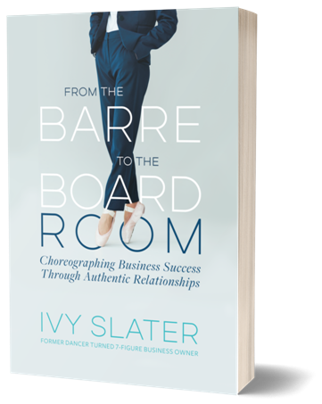
From the Bar to the Boardroom
Notes:
Tell my story… always hated writing, never felt I was good. Had reading issues as a kid, did not start reading until spring break in college. Had every paper I wrote including college – someone to help me with it.
Share Heather Trotta’s story of when she said I had to take all my notes and create a book and I said that would never happen.

Slide 5
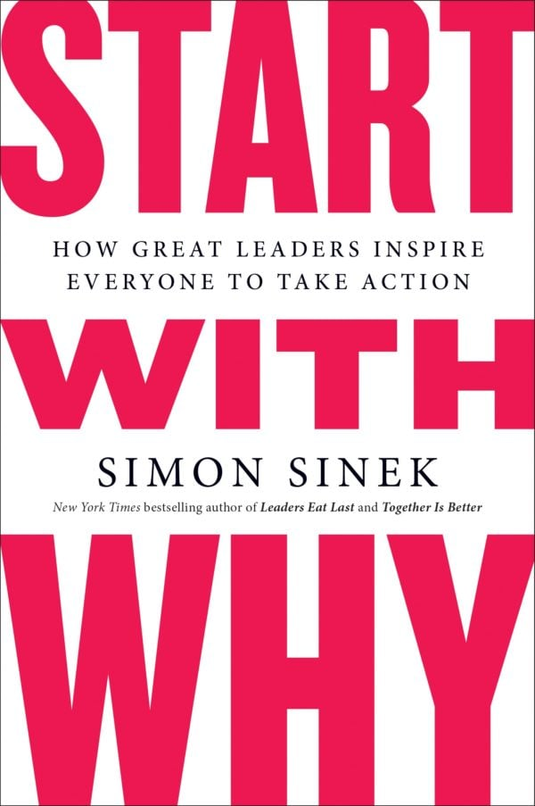
YOUR WHY
YOUR PURPOSE
Notes:
How many of you are familiar with Simon Sinek and his work around Starting with Why. It was published in 2009
Simon Sinek started a movement to help people become more inspired at work, and in turn inspire their colleagues and customers. Since then, millions have been touched by the power of his ideas, including more than 28 million who've watched his TED Talk based on START WITH WHY
Before you get started on working on a book, understand your goal, your purpose your WHY!
The first step is this identify your purpose in writing a book.
Do you write to create a platform for your business & and your methodology
Do you write to have a platform to be a speaker and get paid to speak
Do you write as a thought leader to acquire clients through selling programs
Do you write as a ghost writer
Do you write fiction, mystery, horror, romance, science fiction
Let’s start breaking these down

Slide 6
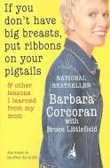
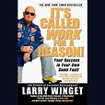


Building a Speaking Platform
Notes:
It takes some amount of celebrity… sometimes the celebrity comes first and sometimes the speaking, writing and teaching comes first.

Slide 7
Celebrity First
Notes:
Steve Harvey was a celebrity before he started writing books and yet he did to enhance his platform. Similar to Michelle Obama
Other times the platform is built first…

Slide 8
Notes:
Barbara Corcoran was a real estate agent
Suzie Orman started as a waitress, got loans to start her own restaurant and then lost the money when she invested at Merryl Linch and then went on to become a broker herself. Then wrote about her past. Great story and interesting read.
Larry Winget is known as the Pit Bull of Personal Development and has built a million dollar brand. All his books are based on his Point of View and has spoken for 400 out of the fortune businesses.

Slide 9
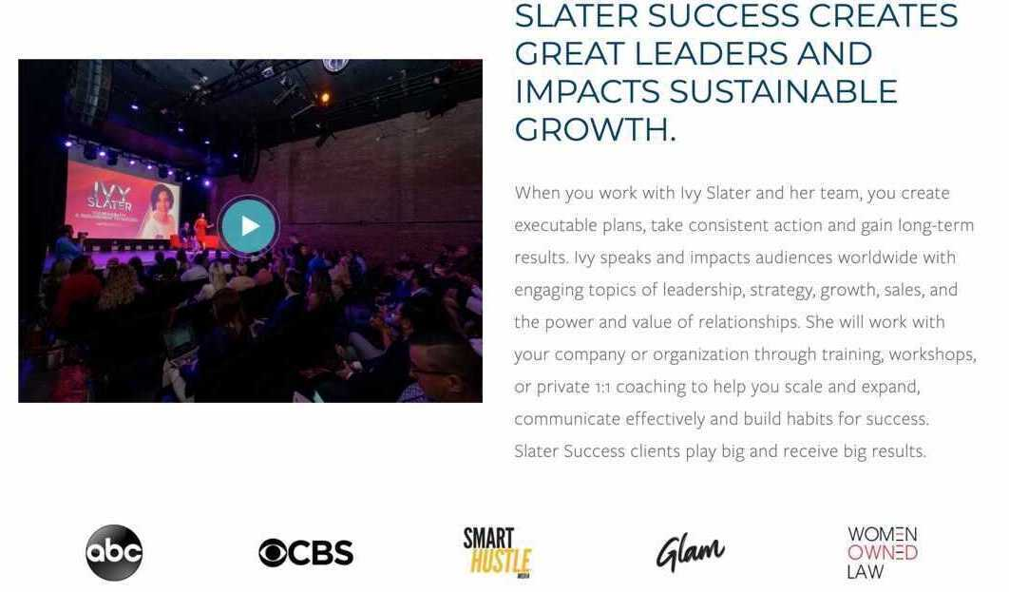
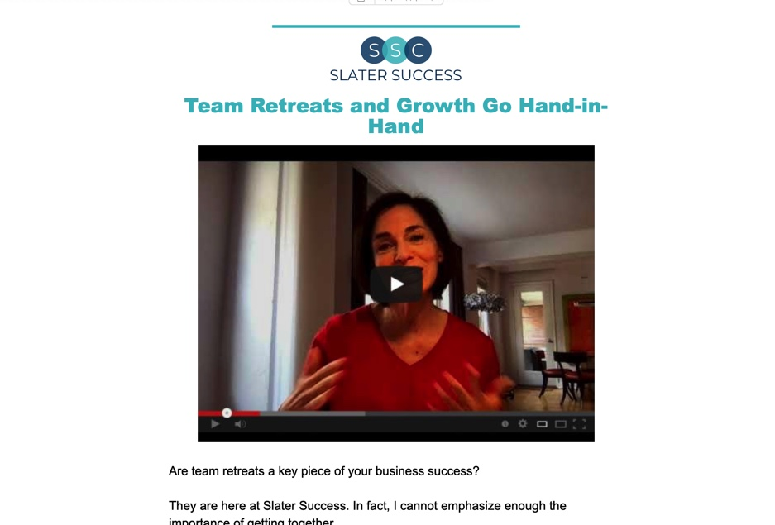
Your book is your greatest marketing & PR tool. From podcast, TV, print, etc. exposure has a ripple effect.
Notes:
People have asked me what drove me to become an author… as I have said before I did not and do not have a desire to write. I do have a strong desire to make a difference through my work. My work with my clients, building strong and successful businesses.
I have a desire to have an impact on my clients life. Supporting them to build the life they desire and having their businesses and careers support that accomplishment.
To do this I knew I had to market. I started my company in January of 2008 and by 2010 I started a weekly newsletter, I have never missed getting one out every Tuesday for the past 11 years.

Slide 10
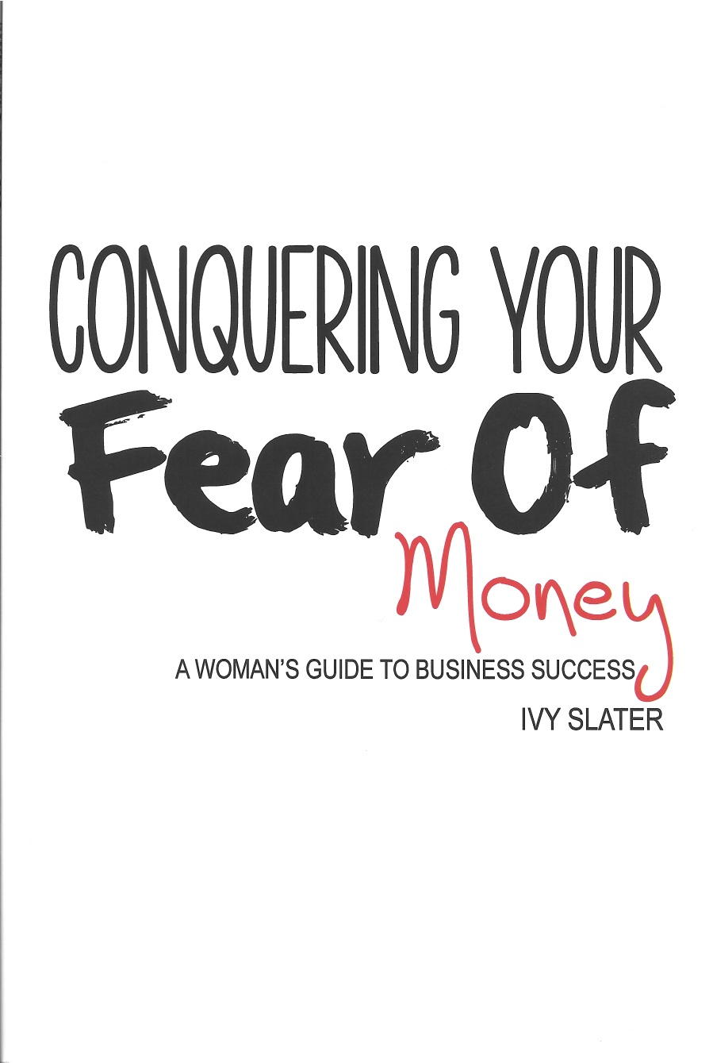
Notes:
In 2014 I was encouraged to start writing a book. Many said you can take a culmination of your newsletters and create a book and I just thought that was the easy way out. If I was going to put a book out there it had to have my thought leadership.
At this time many of my clients were early stage entrepreneurs and one of the biggest challenges I saw they had was navigating the financial aspects of running a business and women especially struggled with their confidence around the finances and asking for their worth.
In 2014, this drove me to write, “Conquering Your Fear of Money, A Woman’s Guide to Business Success”
I used this book exclusively as a platform to book speaking engagements.

Slide 11
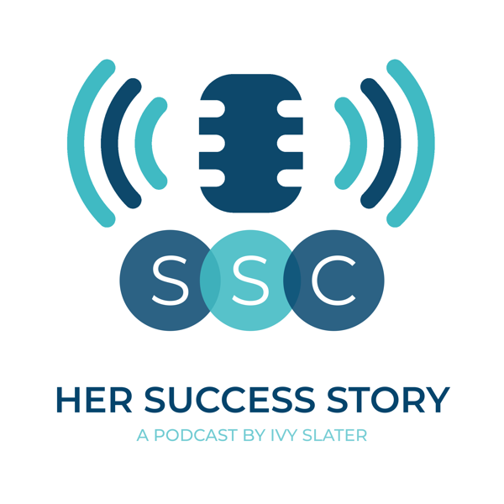
Her Success Story Podcast
Notes:
As marketing continued to evolve, I paid attention. Podcasts were becoming popular and in 2017, I decided to start one to support my marketing efforts. My clients were now larger companies and I thought a great way to meet leaders was to interview them.
A colleague suggested I write a White Paper so I could do interviews and I thought this was a better idea.

Slide 12
From the Bar to the Boardroom
Notes:
I knew it was time to develop a narrower Point of View, I thought Of Larry Winget and his narrow POV and when I thought about all the business and life success I had I knew the POV came down to the power of relationships.
Share Leslie Kobrin story on relationship

Slide 13


ABC and CBS
Notes:
The power of PR in your brand.

Slide 14
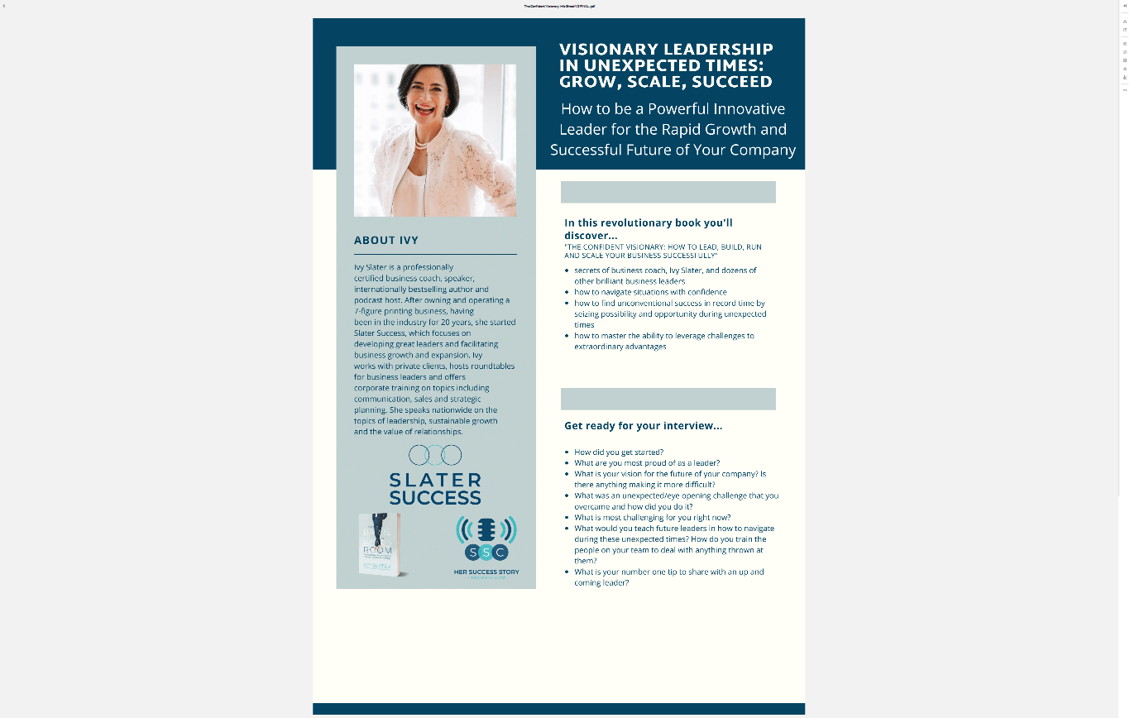
Notes:
Talk about interviews for 3rd book and how this is being used to grow my business… with this concept we have also added in Slater Success Live on Linked in.

Slide 15
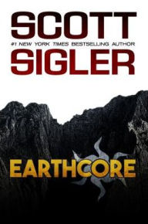
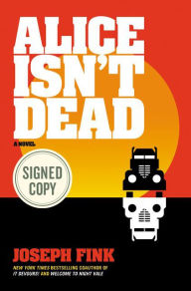
Books and Podcasts
Notes:
Sigler was one of the first authors to see the potential in fiction podcasts. He originally released Earthcore as an early ebook, but when his publisher went belly-up, Sigler decided to try to find a new audience for it in the form of a podcast. It worked: the show eventually gathered an audience of about 10,000 weekly listeners, which he leveraged into a traditional print publication deal.
Speaking of Joseph Fink, he is one of the most successful folks in the podcast-to-book game (and soon the podcast-to-book-to-television game). This story, based on the podcast of the same name, follows Keisha, a long-haul truck driver on a cross-country search for clues regarding the disappearance of her wife, who she refuses to believe is dead even after the funeral. The journey leads her into a complex web of dark conspiracies and stomach-churning terror. Fink was inspired by his experiences living in and out of his van while driving around the country performing live episodes of Welcome to Night Vale; taken as a travelogue of these weird United States, it’s by turns haunting, touching, and downright terrifying, with a particularly memorable villain—a slouching bag of distended flesh known as the Hungry Man—who will stalk your nightmares.
So for those fiction writers out there, there are various approaches that will integrate traditional publishing, non traditional publishing and podcasting.
Slide 9: Target Message, Nike message, Suzie Orman message
I mentioned your Point of View, It is important in marketing and in writing. Be clear on what you stand for… many people believe you have to piss someone off in marketing. That is not true look at the brands above and what they stand for.
Share Allison’s story per Bill Glazer
Glazer Kennedy’s insider circle

Slide 16



Notes:
I mentioned your Point of View, It is important in marketing and in writing. Be clear on what you stand for… many people believe you have to piss someone off in marketing. That is not true look at the brands above and what they stand for.
Share Allison’s story per Bill Glazer
Glazer Kennedy’s insider circle

Slide 17
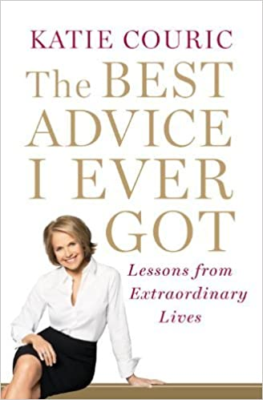
The people you interviewed for you book are a key asset. How do you engage them for mutual success?
Notes:
When you are looking to use writing a book as an asset to building your business, relationship and interviews are wonderful.
I remember reading Katie Couricks books (photo https://www.amazon.com/Katie-Couric-Advice-Lessons-Extraordinary/dp/B00HTK4IDO/ref=pd_lpo_14_img_0/143-6924644-9099519?_encoding=UTF8&pd_rd_i=B00HTK4IDO&pd_rd_r=398864ab-e441-4695-9c45-f022d2ce839a&pd_rd_w=VsFEm&pd_rd_wg=uxvXI&pf_rd_p=a0d6e967-6561-454c-84f8-2ce2c92b79a6&pf_rd_r=520G4VFER39GJ7CD3ZN3&psc=1&refRID=520G4VFER39GJ7CD3ZN3)
I was impressed with her simple question and the response and impact. It came out in 2011 and I often found myself using quotes from parts of the books when I was speaking, training, writing and working with clients.
That always stayed in my mind as I thought about my next book, I knew I wanted to interview high level leaders who navigated challenging times in the past and document their thoughts and ideas around leadership. This came about as the pandemic started and my clients were asking me advise and opinions and looking for support in their decision making. Several of my clients asked how I was staying so calm, and I started sharing
Some of the challenging times I have navigated business through. My attitude was if those did not take me down, this was not going to either.
9/11
Opening the door and ½ office was cleaned out
Father passing
Going financially under
I knew I had a message to get out there and I also knew many other leaders had great insight to this as well. Now I could use my interview method to create future client connections.
Funny thing was about a year before the pandemic I pitched a presentation on resilience for a business conference and it was shut down… in the past year, businesses are looking for insight on resilience.
Tip: There are no bad ideas, there are ideas that are more relevant at different times.

Slide 18
The key differences between just selling a book and acquiring customers for life.
Notes:
Talk about Emily Golden, The New Golden Rule
The New Golden Rule: The Professional Perfectionist's Guide to Greater Emotional Intelligence, A More Fulfilling Career, and A Better Life
This is a book that positions her as a leader in this area.

Slide 19

Doing It All
Notes:
You do not have to do it all… from hiring a ghost writer
Hiring good PR people
Hiring marketing support
Hiring a VA
Delegation is the key to success. The more you let go of the more you can stay in your sweet spot of what you do well. The more you stay in your sweet spot the more successful you will be.

Slide 20

TAKEAWAYS
& IMPLEMENTATION

Slide 21
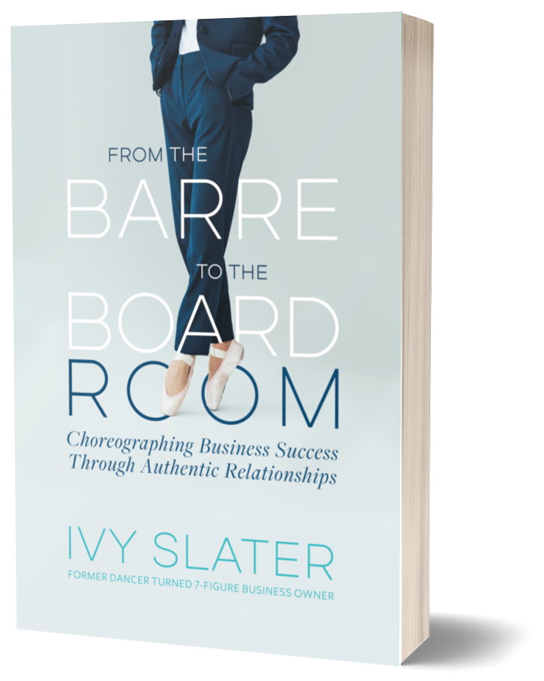

Stay Connected!
WWW.SLATERSUCCESS.COM
Barre to Boardroom
Her Success Story
How To Be A Visionary Leader In Unexpected Times
LinkedIn https://www.linkedin.com/in/ivyslater/

