Slide 1
Book Publicity 101

Slide 2
Timeline
6 Months To 1 Year Before Publication:
Social Media:
At least 6 months to 1 year prior to your book’s publication, begin to engage on social media.
Do: Be authentic; Be generous; Be consistent.
Do: Announce Your Book with a cover reveal, event dates, short excerpt, etc.
Don’t: Only talk about your book or yourself.

Slide 3
Timeline
3 to 6 Months Before Publication:
Blurbs: If you don’t have blurbs/endorsements already, now is the time to get them.
Press kits & Media lists: should be created. You can write your own press materials. Media lists can be compiled using your own contacts and/or a paid media database service.
Events: should be scheduled at bookstores or other speaking venues.
Net Galley: This is when your book should go up on Net Galley or a similar digital galley provider. NetGalley is important because it is one of the best ways for an author to connect directly with bloggers, reviewers and other media.
Galley Mailing: Now is the time to get your physical galleys mailed out to trade reviews, monthly magazines, major book review editors at print newspapers and websites, as well as any national broadcast media.
Good Reads: If you haven’t already done this, make sure your book is on Good Reads and consider doing a Good Reads book giveaway.
Events should begin to be scheduled now.
Social Media If you haven’t already announced your book on social media, now is the time to do it, as well as spreading word of any events, great blurbs, etc.

Slide 4
Timeline
3 Months to 6 Weeks Before Publication:
Media Lists: Create media list for finished books. Examples of media targeted in this list would be producers at podcasts and radio shows; freelance writers, bloggers and more print/online reporters/editors. These media lists should include contacts that will be emailed first and then sent books if they express interest, as well as contacts to whom you should send books to before follow ups are done.
Galley Follow Ups: Follow up with the media to whom galleys were sent. Remember that many book review editors have a policy of not giving out the review status of a book but following up is still a good idea. That being said—there is a limit on how often it is prudent to follow up with any given media contact.
Net Galley: Engage with readers/media on Net Galley and so you can begin to see reviews posted on sites such as Good Reads, Net Galley and blogs.
Original Essays/Op-Eds: This is the perfect time for authors to start placing any original essays or op-eds.
Finished Book Mailing: 6 weeks to 4 weeks in advance of a books publication is when finished books are traditionally sent to media.

Slide 5
Timeline
2 to 6 Weeks Before Publication:
Pitch: This is when most interviews are booked, reviews are confirmed and when any publicist will be the most busy working on a book.
Schedule: interviews/coverage on podcasts, radio shows, blogs, websites, etc for right before or after a book goes on sale.
Publicize Events: Make sure you have a crowd at your events by inviting all your friends and friends of friends wherever you are speaking. Make sure the events venue is also doing their part in spreading word of the event.
Amplify: Spread the word about anything happening on your book-reviews, endorsements, interviews, events— via social media, your website, newsletter, etc.

Slide 6
More on Media Lists & Events
Media Lists:
Your own contacts are critical: Whether you are a self-published author or being published by a big house, your own media contacts can be critical.
Subscription media database: Anyone can subscribe to a media database such as Cision or MuckRack to pull media lists. These will provide you with journalists contact information as well as their beat and whether or not they are a PR contact.
NetGalley: Connects you directly with the media and bloggers.
Social Media: Following journalists on social media allows you to connect directly if you have a relevant story or angle. You can also add journalists you identify as being important to your media lists.
Events:
Scheduling An Event: Only schedule an event that you can bring an audience to or with a bookseller/venue that is excited to host.
How to Reach Out: Most independent bookstores list information on how to schedule an event on their website. If you do reach out directly, make sure to emphasize the crowd you can bring in as stores don’t want to schedule events that are not successful.
Collaborate: With the events coordinator, and your publicist if you have one, to get out the word about the event to any contacts you have in the area and any media contacts the store may have to ensure you have a great event.

Slide 7
Press Release Basics
Must Haves:
Publicist or Publisher Contact Information.
Book Information: Title, Author, On Sale Date, ISBN, Price, Pages.
Book Jacket and/or Author Photo.
Book Description:
A short summary of the book. This can be similar to flap copy or catalog copy.
The whole release should fit on a single piece of paper, double sided.
Author Info:
Short bio, web address, social media handles.
Background that is interesting or relevant that is not in the bio.
Why Do We Care:
Praise-either blurbs or quotes from reviews.
Information on awards for the author or the book.
Connections to relevant news stories, the season, or even a place.

Slide 8
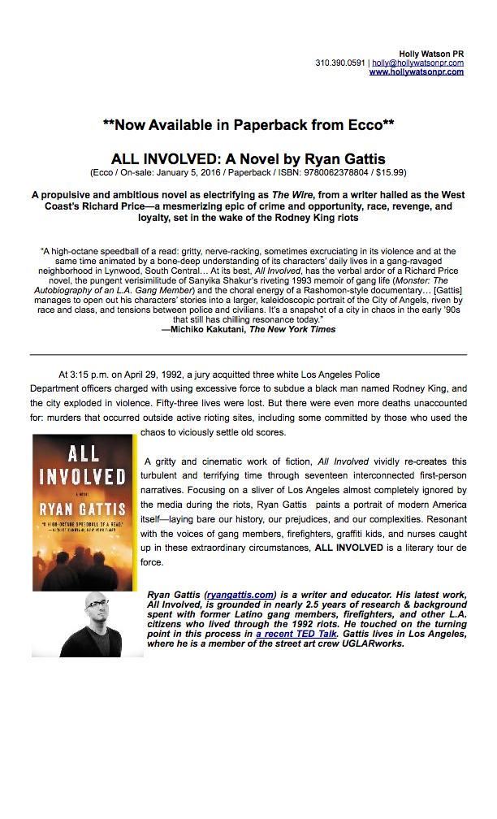
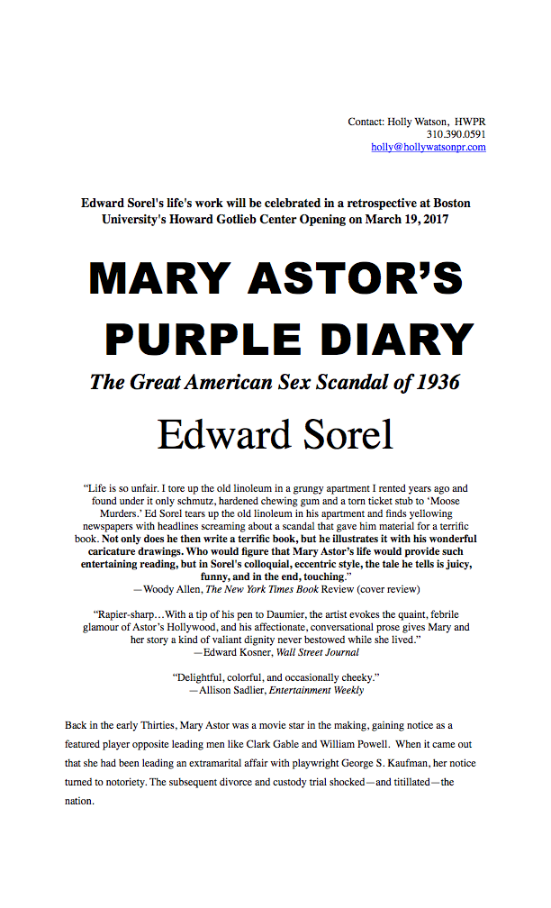
Example:

Slide 9
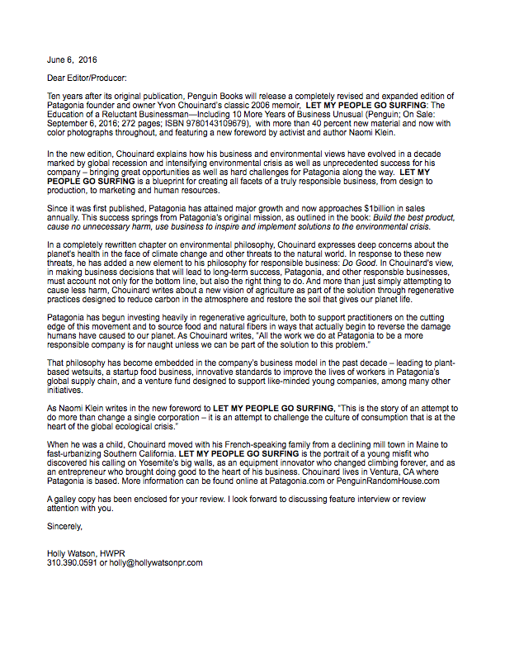
Evolution of A Press Release Part One:
The Galley Letter: If the book is being made available as a galley then the galley letter will come first and will form the basis of the press release.
Galley Letter vs. Press Release:
What’s Different: Format; Blurbs or Quotes; Length
What’s the Same: Book Description; Author Info
Galley Letter
Press Release

Slide 10
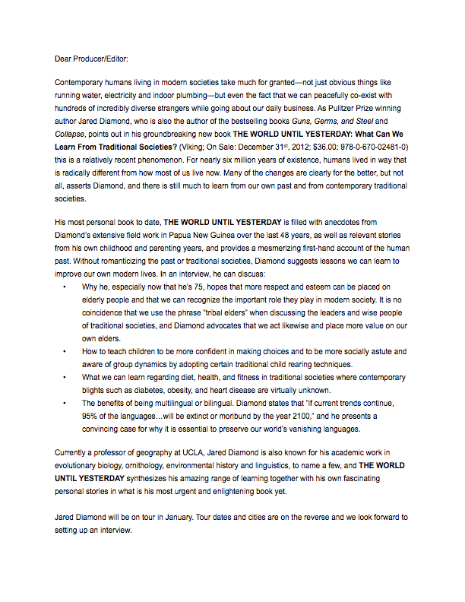
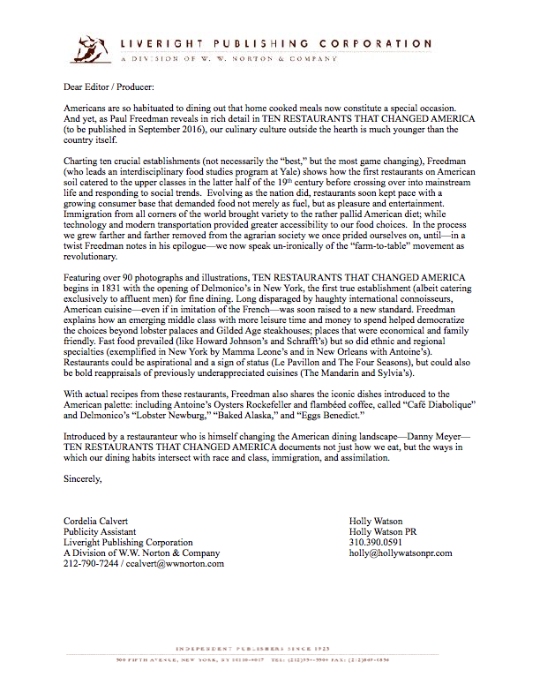
Evolution of the Press Release Part Two:
The Pitch Letter: The most standard accompaniment to the press release.
Similar to the press release but expands on the book description, with more reasons on why the author should be interviewed.
Often uses bullet points to highlight talking points and/or to detail out features such as photos, recipes or new information within the book.

Slide 11
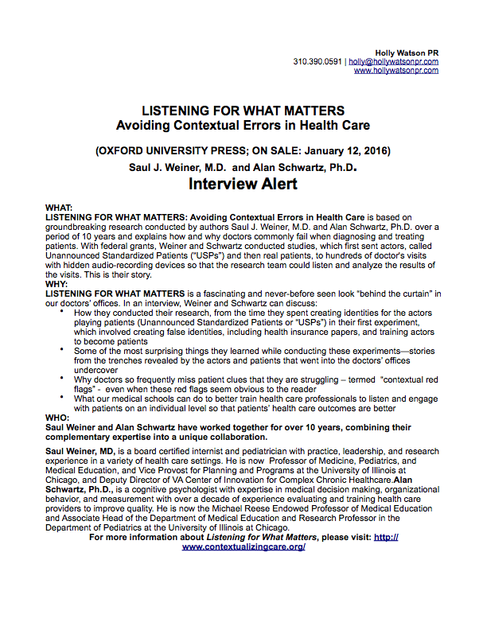
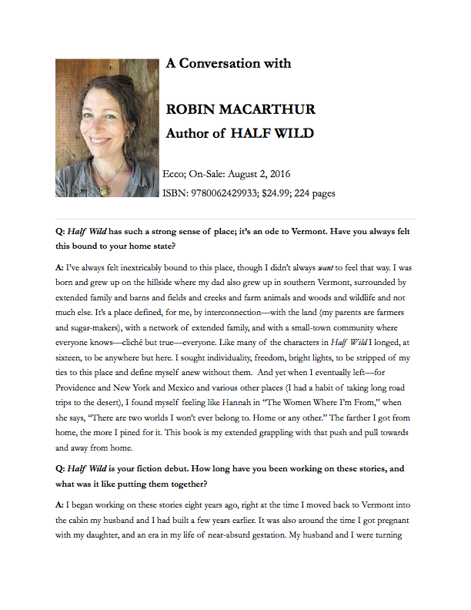
Evolution of the Press Release Part Three:
The Interview Alert: The pitch letter in different clothes. Occasionally useful when creating the pitch email.
Q&A: Sometimes a Q&A with an author can be helpful to have on hand, especially if the book is dense or if the author has an interesting back story.
Interview Alert:
Q&A:

Slide 12
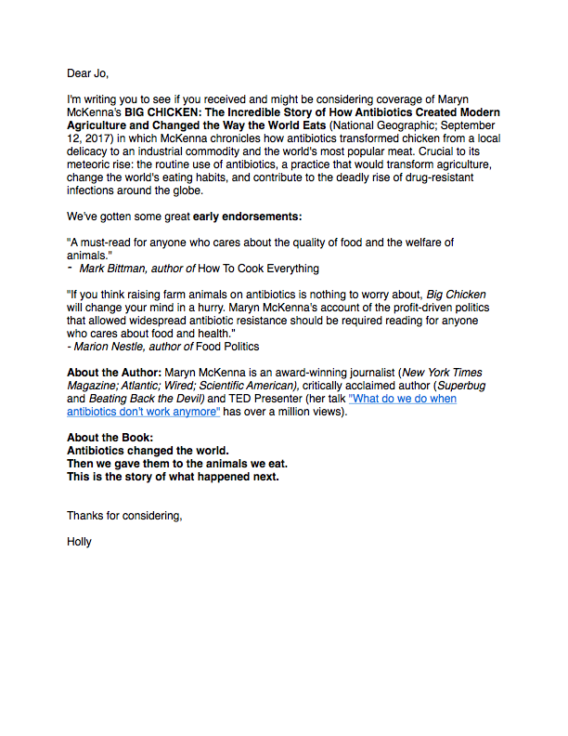
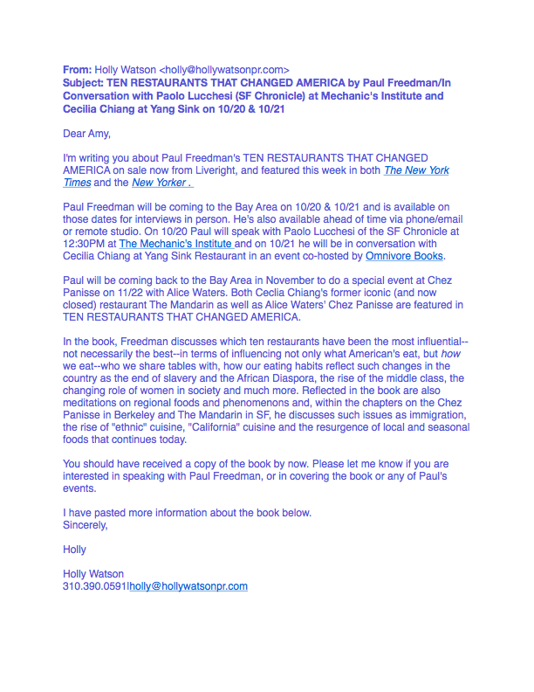
How the Press Release Is Really Used:
It Gets Emailed: Most pitches are now done via email. People aren’t going to read a full length PR in standard PR formatting on their email.
And Individualized: While a few lines from that tried and true PR will remain in its same form through many different pitches, each media contact should be approached individually, based on who they are, where they are and what’s going on in the world when you pitch them.
And forms the basis of information for some interviewers: Not all media contacts will read a whole book before covering, so sometimes the press materials are crucial in forming the basis of interview questions. This is especially true of “pitching extras” like interview alerts, pitch letters or Q&A’s.

Slide 13
Why Hire a Book Publicist
What Can a Book Publicist Do that is Different from What the Author Can Do?
Create Media Lists: based on her own lists, and most importantly, experience working with the media, as well as those of a paid media database.
Pitch: the book to journalists and get the book in front of book review editors that do not welcome non-PR people contacting them.
Schedule Events: Publicists may have connections with stores and venues that you are not connected with and/or be able to coordinate events with stores that would not ordinarily work directly with authors.
Keep Following Up: Publicists can be persistent with media contacts (even those the author is “friends” with) far beyond the point when the author following up alone would be annoying.
Discover: new opportunities for your book. Publicists are always pitching multiple books at a given time and this can lead to new opportunities for authors.

Slide 14
What to Expect from a Book Publicist
Depends on Your Price Range: Publicists will charge anywhere (in general) from $3,000.00 to $20, 000.00 and what you pay largely determines what you get in terms of scope of work, length of commitment, level of service, etc.
Depends on Your Book: Fiction? Non-fiction? Memoir? Biography? Genre? How To? Self-Help? Cookbook? All these books are received by the media in radically different ways and therefore require radically different publicity campaigns. Some kinds of books will definitely benefit more than others from having a publicist involved.
Always Expect: Feedback and updates in a timely manner and remember this is something that should be discussed ahead of time when you negotiate your contract. Also remember that if your publicist is working with you for several months, there will be times when you are in constant communication and times when you are in touch less frequently.
Don’t Expect: Guaranteed book reviews. Unless a paid review is being arranged, a publicist cannot definitively promise print review coverage in particular. In general, a publicist should be able to give you a sense realistically ahead of time of what to expect in terms of publicity for a given book based on her past experience, and media connections, but reviews, in particular are never a given.
Ask Questions: Air all of your questions and concerns before officially signing on to work with a publicist. Feel free to ask for references or endorsements from past clients.
Collaborate: You and your publicist are a team. You can decide ahead of time to outsource much (or all) of the publicity work to your publicist OR you can decide to divide and conquer. Whatever you decide, remember that you are both working to the same end.

Slide 15
Keep it Moving
How Do You Keep Things Going? Your book has been on sale for a few months…now what?
Book Clubs: If you can connect with book clubs via Good Reads, local bookstores and social media, this can be a great way to keep interest in your book alive and well for a long time after it has originally gone on sale.
Awards: There are many awards opportunities available for books out there. Most of them require that you submit the book in the year or year and a half following publication.
Book Festivals: Book Festivals are great opportunities to meet new audiences and garner more publicity for your book. In general, it’s easy to submit yourself for a book festival and there are many happening all over the country.
Professional Conferences: If appropriate, use your book to leverage your opportunities to speak at professional conferences. Sell your book wherever possible but be aware that some conferences may not allow books for sale but are still good ways to spread the word about your book.
Keep Current: If your book relates to something happening in the news or even to something seasonal (Taxes, Halloween, Valentine’s Day, etc.), you may have a great opportunity for renewed publicity.
Stay active on social media.

