Slide 1

Metadata: Simple Strategies
With Pam Sheppard
Sheppard Editorial Services
© 2025 Sheppard Edits

Slide 2
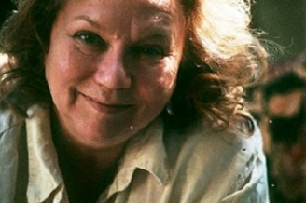
Your Presenter:
Pam Sheppard
Market Smart Edits and Consulting
Publishing Consultant
Metadata Analyst and Coach Short Content Specialist Developmental Editor
Book Doctor
© 2025 Sheppard Edits

Slide 3
Our checklist for today: > Who What Why Metadata > Components for your metadata > Putting Metadata together
© 2025 Sheppard Edits

Slide 4
Metadata: the Why
Clear, succinct details TRANSFER DATA for your book into publisher and retail databases, platforms, and Amazon framework.
Allows easy CATEGORIZATION by retailers, libraries, and wholesalers.
Strategy for DISCOVERY by readers to find your book and persuasion to BUY.
© 2025 Sheppard Edits

Slide 5
Start with
Simple SOURCE components:
Physical details and source details
© 2025 Sheppard Edits

Slide 6
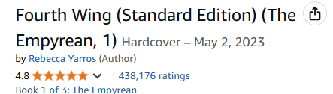

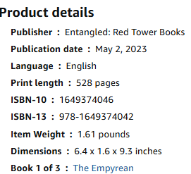
Title / Subtitle
Series
Format
Author
(Ranking estab by Amazon)
The simple components:
© 2025 Sheppard Edits

Slide 7
NEXT: Strategic PERSUASIVE Components:
Cover
Primary Audience & Price
Categories and/or BISAC subject codes
Keywords
Description
© 2025 Sheppard Edits

Slide 8

© 2025 Sheppard Edits

Slide 9
But FIRST: take another look at your book
© 2025 Sheppard Edits

Slide 10
What does it bring to the party?
© 2025 Sheppard Edits

Slide 11
Determine your book’s Marketing ASSETS and STRENGTHS
© 2025 Sheppard Edits

Slide 12
What are your project’s ASSETS? Find them in your basic premise:
SETTING CHARACTER PROBLEM OPPOSITION CHOICE
© 2025 Sheppard Edits

Slide 13
Your Fiction Market Strengths FICTION Conventions vary by GENRE
\
SETTING
CHARACTER
PROBLEM
OPPOSITION
THE CHOICE
LOCATION
TIME
CONDITIONS
GENRE
AGE
APPEARANCE
FLAW
DESIRE
INTENTION
MOOD
GOAL
CHALLENGE
FEAR
STAKES
OPPORTUNITY
PRIZE
MISSION
OBSTACLE
CHALLENGE
THREAT
COMPLICATION
RISK
STEP UP
GIVE IN
LET GO
© 2025 Sheppard Edits
Sheppard Edits© 2024

Slide 14
Your Nonfiction Market Strengths
Target
Consumer
Problem
to solve
Opposition to Overcome
Setting
The Choice
SITUATION
TIME
CONDITIONS
GENRE
Demographics
NEED
DESIRE
INTENTION
MOOD
CHALLENGE
FEAR
STAKES
OPPORTUNITY
PRIZE
MISSION
TAKE A RISK
STEP UP
WORK - LEARN
GIVE IN
LET GO
OBSTACLE
CHALLENGE
THREAT
COMPLICATION
INADEQUACIES
© 2025 Sheppard Edits
Sheppard Edits© 2024

Slide 15
NOW you’re ready for keywords
© 2025 Sheppard Edits

Slide 16

re-Assemble your CORE STRENGTHS
KEYWORDS – align with trends
GENRE – subgenre options
TONE – alternate viewpoints
STORY ELEMENTS – which can lead?
WRITING STYLE
MATCH:
Your Ideal Reader - Adjacent Readers TRENDS - Genre Mashups

Slide 17
Looking for Keywords? (check your COMPS!)
© 2025 Sheppard Edits

Slide 18

LOGLINE:
Enter the brutal and elite world of a war college for dragon riders from #1 New York Times bestselling author Rebecca Yarros *Twenty-year-old Violet Sorrengail was *supposed to enter the Scribe Quadrant, living a quiet life among books and history. Now, the commanding general―also known as her tough-as-talons mother―has *ordered Violet to join the hundreds of candidates striving to become the *elite of Navarre: *dragon riders. But when you’re *smaller than everyone else and your body is brittle, death is only a heartbeat away...because dragons don’t bond to “fragile” humans. *They incinerate them.
Key phrases:
Character
Belief
Goal
Flaw
Obstacle
© 2025 Sheppard Edits

Slide 19
 family secrets • psychological pain • character study
 nordic noir • endearing characters • shocking plot
 midwestern farmlands • gritty • unexpected romance
 hired assassin • villainous protagonist • dark humor
*ASSEMBLE KEYWORDS into your DESCRIPTION
© 2025 Sheppard Edits

Slide 20

https://publisherrocket.com/
Keyword database - Category database
© 2025 Sheppard Edits

Slide 21
DESCRIPTION:
Not a chapter
Not an Elevator Speech Not a Summary
© 2025 Sheppard Edits

Slide 22

Wait. What?
© 2025 Sheppard Edits

Slide 23
Why does this book matter?
What makes it unique?
(or even the same?)
© 2025 Sheppard Edits

Slide 24
Introduce the strengths
Share the emotional core that resonates
Keywords & keyword strings
Include factors for a decision to buy
*Represent your style!
© 2025 Sheppard Edits

Slide 25
COMPONENTS OF DESCRIPTION 200 - 500 words
Logline – 1 or 2 line intro or tease
Title line with Sub-title
DESCRIPTION
STORY ARC (premise)
KEYWORDS shared with comp titles
EMOTIONAL TONE
Sample of your STYLE
KEY SELLING POINTS
STRONG CLOSE
© 2025 Sheppard Edits

Slide 26

“After Tova Sullivan’s husband died, she began working the night shift at the Sowell Bay Aquarium, mopping floors and tidying up. Keeping busy has always helped her cope, which she’s been doing since her eighteen-year-old son, Erik, mysteriously vanished on a boat in Puget Sound over thirty years ago.”
** OVERLOOKED ASSET !
Hint of an unexpected, intelligent,
empathetic creature
© 2025 Sheppard Edits

Slide 27

“For years, rumors of the “Marsh Girl” have haunted Barkley Cove, a quiet town on the North Carolina coast. So in late 1969, when handsome Chase Andrews is found dead, the locals immediately suspect Kya Clark, the so-called Marsh Girl. But Kya is not what they say. Sensitive and intelligent, she has survived for years alone in the marsh that she calls home, finding friends in the gulls and lessons in the sand. Then the time comes when she yearns to be touched and loved. When two young men from town become intrigued by her wild beauty, Kya opens herself to a new life—until the unthinkable happens. Where the Crawdads Sing is at once an exquisite ode to the natural world, a heartbreaking coming-of-age story, and a surprising tale of possible murder.
Owens reminds us that we are forever shaped by the children we once were, and that we are all subject to the beautiful and violent secrets that nature keeps.”
© 2025 Sheppard Edits

Slide 28

“Uncommon Favor reveals the journey that led to Staley’s success, including the challenges she faced. From dealing with sexism on the court to feeling isolated in new environments, Staley honed her skills and learned valuable life lessons about mental fortitude and maturity that have grounded her throughout her career. ”
** OVERLOOKED ASSET !
Not just a basketball player –
A major figure for changing
the entire landscape of the game
© 2025 Sheppard Edits

Slide 29

HOOK: MAKES YOU LOOK
© 2025 Sheppard Edits

Slide 30
*NOTE: HOOKS are hard to create.
They often appear unexpectedly, as part of a joke, or in a dream, or while stirring the soup.
You’ll know when the right phrases hit.
A good LOGLINE can be sufficient until your hook surfaces.
© 2025 Sheppard Edits

Slide 31

One day, the mother was a mother,
but then one night,
she was quite suddenly
something else…
© 2025 Sheppard Edits

Slide 32

Meet Ove.
He’s a curmudgeon.
© 2025 Sheppard Edits

Slide 33



Lexie’s got the perfect life. and someone else wants it…
A Japanese Sherlock in Compton
An extraordinary final wish brings five lives together forever
© 2025 Sheppard Edits
9/14/25
33

Slide 34
Suggested Book Page Layout
© 2025 Sheppard Edits

Slide 35
HOOK / Logline – in BOLD
*
ESTABLISH SETTING, GENRE, STYLE in 2 sentences
*
Introduce the CHARACTER, the challenge. Make them appealing.
*
Announce the CRISIS POINT with intensity, emotion, or stakes
*
Main character’s CHOICE
*
COMPS or Call to Action – the last PULL on your reader
to persuade them to buy.
© 2025 Sheppard Edits

Slide 36
Useful Sources: https://kdp.amazon.com/en_US/help/topic/G201097560 https://www.ingramspark.com/lp/metadata-checklist https://publisherrocket.com/
© 2025 Sheppard Edits

Slide 37
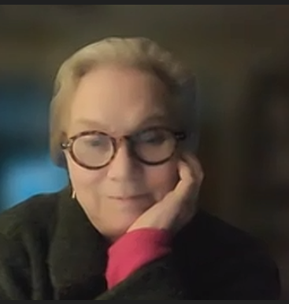
Thank You!
www.sheppardedits.com
Email: sheppardedits@gmail.com
© 2025 Sheppard Edits
9/14/25
37

